Slide 1
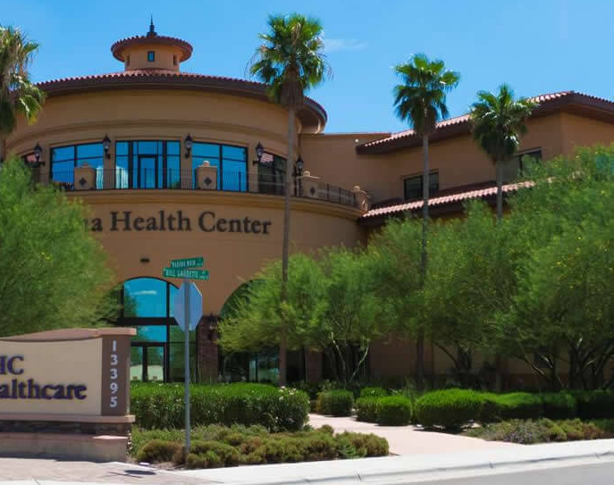

340B Enhanced: Referral Capture Solution
Marana Healthcare Center
Federally Qualified Health Center in Southern Arizona
17 – Clinic Locations
132 – 340B Contract Pharmacies
3 – 340B Third Party Administrators
Case Study
May 2020

Slide 2
340B Enhanced – Marana Healthcare Case Study
Capture referral scripts missed by 340B administrators
Generate additional revenue without changing administrators
Significant increase in 340B Revenue (see below)
No financial risk - PHS’s is completely aligned financially with the CE
Requires no new technology or human resources
Significant Value has been generated for Marana Healthcare
Phase I of the implementation consisted of 16 contract pharmacies (out of 132 total pharmacies)
Phase II Inclusion of additional Contract Pharmacies driving even more monetary value to Marana.
PHS originally estimated $39,000 of added revenue monthly is available by reviewing the “fall out” claims to the medical records of the hospital for potential referral claims.
After a detailed review of more than 1,770 high value claims, PHS delivered the following results to Marana Health Care
63 Claims representing $47,370 in added value for Marana Healthcare
  34 Claims qualified and captured representing $19,250 of additional revenue in first month.
  29 Claims placed in pending added EHR documentation. These claims represent (if qualified) an additional $28,120 of value for Marana Healthcare.
Most of these have refills, creating a base recurring monthly revenue stream
Title Here
Confidential Work Product of Pharmacy Healthcare Solutions, LLC all rights reserved

Slide 3
340B Enhanced: Additional Information
340B Enhanced Benefits Review…
No financial risk to Covered Entities. We charge only when we identify and process additional 340B qualified prescriptions
Referral prescriptions often include specialty and high cost medications, which fills the 340B gap for specialty prescriptions
Requires no new Covered Entity resources—We provide all the human resources required
Requires no additional technology or EHR interfaces by Covered Entities
340B Enhanced does not require a change your 340B Administrator
What does it take to get started?
BAA/PHS Agreement
Program onboarding:
  Meet with the CE’s 340B team, agree upon P&P’s
Obtain claim data from TPA, secure access to EHR system, configure in PHS system
Audit claims for referral capture and review with covered entity
Reclassify the claims as 340B eligible with the TPA
Contact Us
Marana Healthcare Center Reference Contact:
Greg Redding, PharmD.
Pharmacy Director
gredding@mhchealthcare.org
520-682-4111
PHS Representative:
Tim Liebmann, CEO
Tim.Liebmann@performancehealthcaresolutions.net
215-534-8353
Title Here
Confidential Work Product of Pharmacy Healthcare Solutions, LLC all rights reserved

